Slide 1
PASS CAMP
DBA Track

Slide 2
speaker questionnaire
Name : Rob
Occupation : DBA, Automator, Do-er, Trainer, DevOpser!
Available for hire ☺ - RobSewell.info
Interests : PowerShell, Automation And SQL (PaaS geddit?)
Speaker : PsConfEU, PsConfAsia, PSSaturdays, PSMondays, User Groups PowerShell and SQL
Community : PowerShell VG, PowerShell Conference EU Organiser, PSDayUK Organiser, SQL South West , SQL Sat Exeter dbareports, dbatools, SQLDiagAPI, MVP
https://SQLDBAWithABeard.com @SQLDBAWithBeard

Slide 3
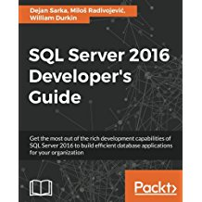




speaker questionnaire
Name : William Durkin
Occupation : Data Platform Architect
@ datamasterminds.io
Experience : 10+ Years with SQL Server
DBA / System Architect
Community : Data Platform MVP (March 2017)
williamdurkin.com
@sql_williamd
williamdurkin@datamasterminds.io

Slide 4
s TO DO LIST
TODAY’
GET UP
Drink Appropriate Liquid
Learn About PowerShell, Cloud, Open Query Store and More
Have fun

